Slide 1
Exploratory Data Analysis Airbnb & Football players data

Slide 2
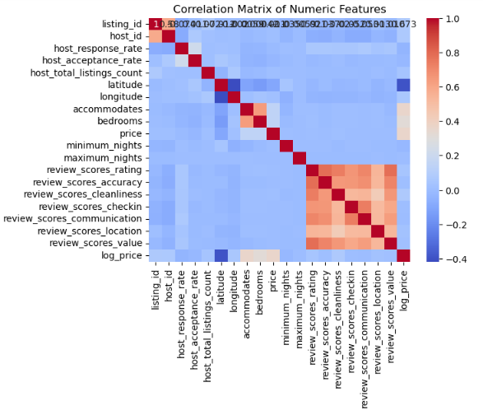
Introduction (Airbnb)
Objectives and Methodology :
Data preparation and analysis
Find patterns and correlations within dataset
Findings and conclusion
Data Cleaning and Preprocessing:
handling missing value
transforming skewed data
Identifying key features
Exploring the Listings data:
Understanding the distribution of prices
Understanding correlations:
Relationship between price and other variables
Notes:
positive correlation between the number of accommodations and price, which is expected. It's interesting to note that location scores also correlate positively with price, underscoring the adage of 'location, location, location' in real estate and hospitality

Slide 3

Key Findings
Conclusions:
room type, capacity, and location quality are pivotal in setting the right price.
We also highlighted the importance of maintaining high review scores.
Recommendations:
Consider adjusting prices based on the number of bedrooms and accommodation capacity to align with market trends.
Manage listing quality to enhance guest satisfaction
Project expansion:
predictive models that could help hosts set competitive prices and maximize their earnings
Notes:
We concluded that room type, capacity, and location quality are pivotal in setting the right price. We also highlighted the importance of maintaining high review scores, especially in terms of cleanliness and communication.".
Hosts can optimize their pricing and enhance listing features that align with guest preferences, such as location and accommodation size. For Airbnb, there's an opportunity to guide hosts with data-driven recommendations for pricing and amenities.
To wrap up, our analysis provided us with several actionable insights. We concluded that room type, capacity, and location quality are pivotal in setting the right price. We also highlighted the importance of maintaining high review scores, especially in terms of cleanliness and communication

Slide 4


Football Player
Ibrahim Alawi
Abdullah Alfadel

Slide 5
Raw Dataset
17953 Rows
51 Column
Data types: float64(7), int64(35), object(9)
Shape (51, 17953)

Slide 6
Dataset After Cleaning and feature engineering:
16181 Rows
48 Column
Data types: float64(4), int64(35), object(8),date(1)
Shape (16181,48)

Slide 7
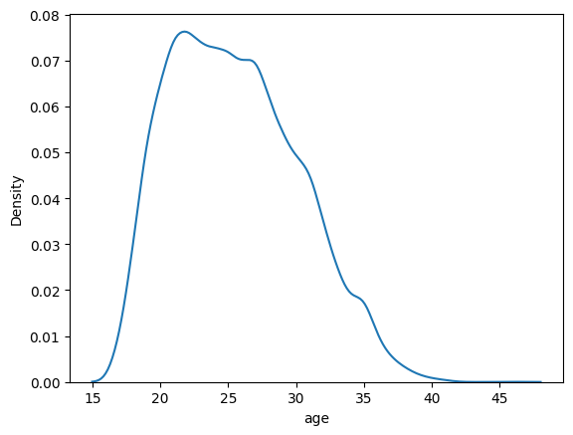

Slide 8
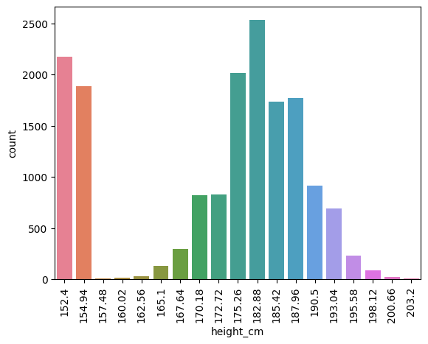

Slide 9
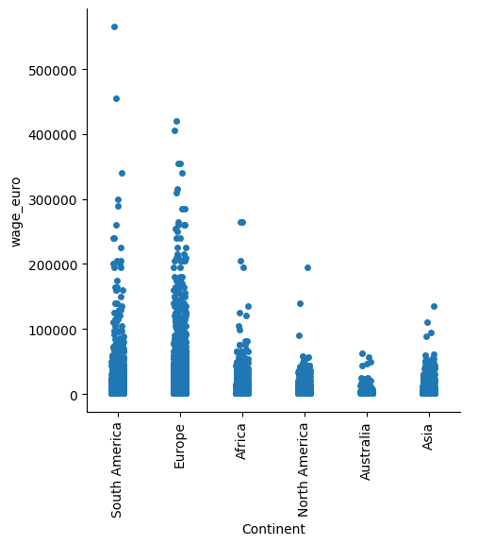

Slide 10
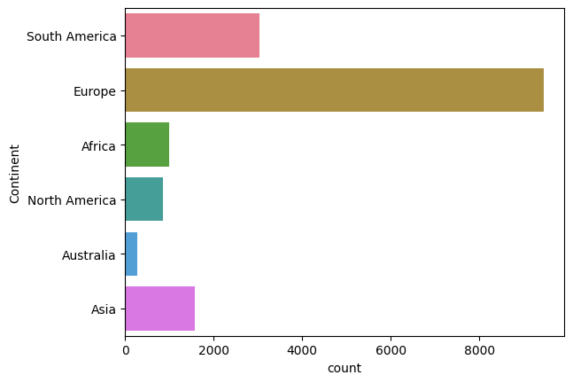

Slide 11
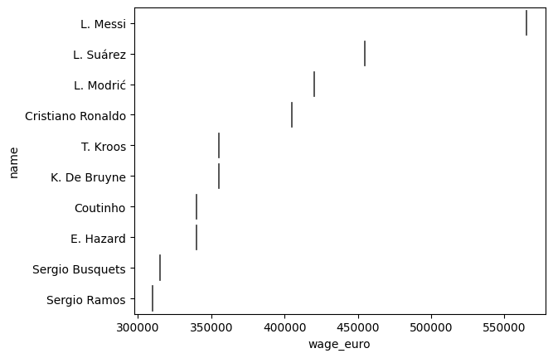

Slide 12
THANKS
Any questions?

